Slide 1
DWR Products
Jan Mohmmad
Scientist D, UAID Radar,
New Delhi

Slide 2
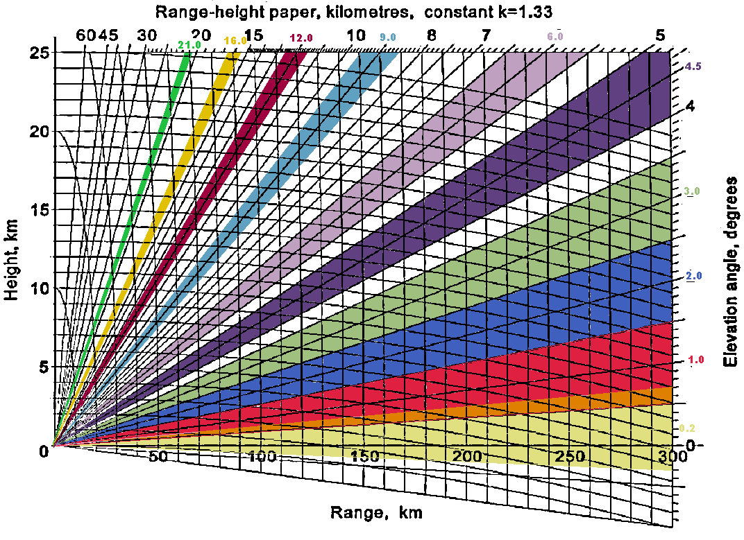
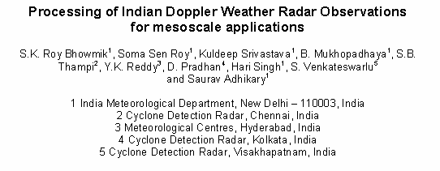
Prevailing Scan strategy - Experts panel recommended
Radar experts and users group had a brain storming session and have come up with a proposal for the scan strategy as shown in fig; a concept paper on the above subject “Processing of Indian Doppler Weather Radar Observations for mesoscale applications”, is under peer review

Slide 3
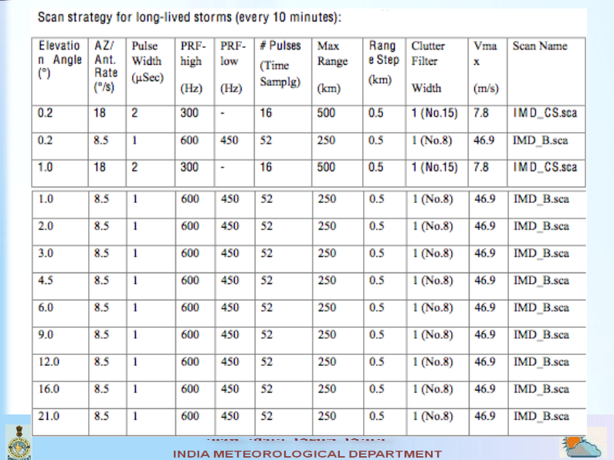

Slide 4
Advantages of prevailing Scan strategy
Overlapping at the lower elevation scan to give a better derived product of Rainfall and low level wind shear.
Similar to that of VCP21 of NexRad Network, considered to be having a good volume cover
Has ten elevation cuts enabling to perform scan within ten minutes
Cone of silence minimized to that of VCP21
Has high temporal and spatial cover – tracing of a meso-scale system good
Suitable for generating a mosaic product (especially precipitation) if another radar is present within 200 – 400 km

Slide 5
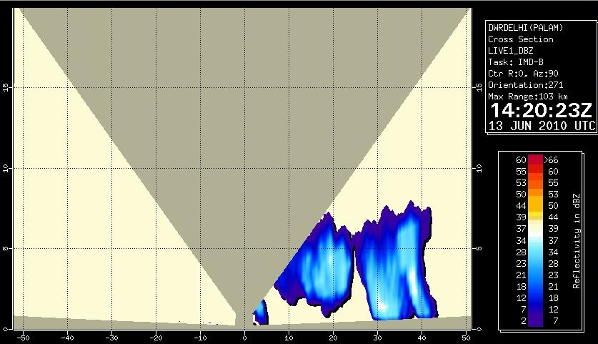
Cone of silence - Palam Radar Enlarged view
40% of crucial volume of interest not scanned by the radar

Slide 6
Surface Rainfall Intensity (SRI)
It is an image of the rainfall intensity (in mm/hr) in a user selectable surface layer. It is calculated based on Marshall-Palmer equation
Z=ARb
where R is the rainfall intensity and A and b are constant. The value of A & b varies from season to season and place to place.
sRI is mainly used as an input product to generate rain1 (hourly rain accumulation) product.
The SRI generates an image of the rainfall intensity in a user selectable surface layer with constant height above ground.
The product provides instantaneous values of rainfall intensity.

Slide 7
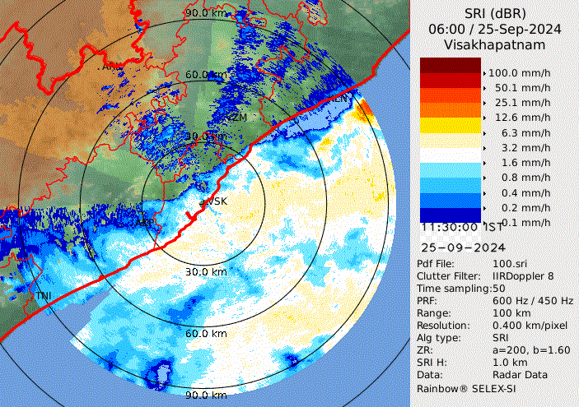
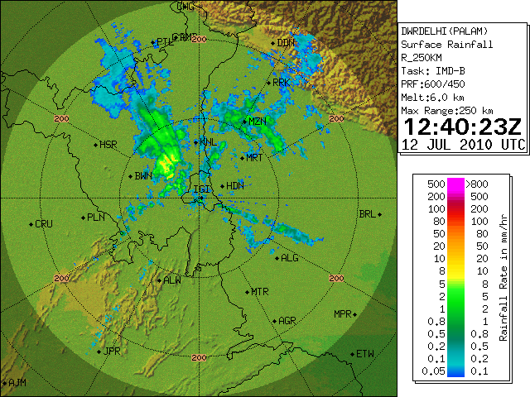

Slide 8
PAC (Precipitation Accumulation)
The PAC product is a second level product.
It takes SRI products of the same type as input and accumulates the rainfall rates in a user-definable time period (look back time).
Every time a new SRI product is generated, the PAC generation starts again.
The display shows the colour coded rainfall amount in [mm] for the defined time period. The display is similar to SRI product

Slide 9
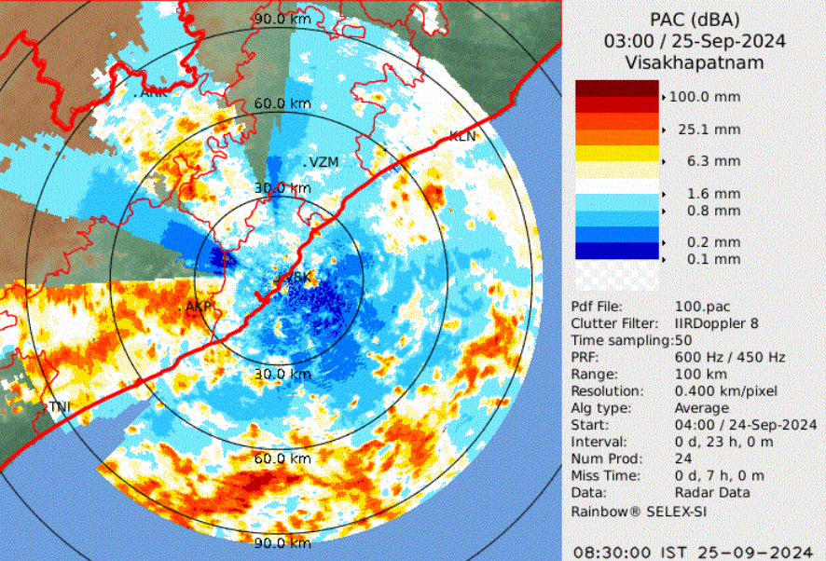

Slide 10
Rainfall Intensity Histogram (RIH)
Rainfall Intensity Histogram is a second Level product. It takes SRI product as input.
The RIH product provides information about the rainfall intensity at selected locations (specified by user) within radar coverage area during user defined time period.
The rainfall intensity versus time for the selected locations is displayed in multiple histogram style. The accumulated rainfall values in mm for the time period are also indicated.
The SRI product defined in the RIH product definition file acts as a trigger for generation of RIH product. Whenever a new SRI product is generated, SRI values for selected locations are read out of SRI and a new histogram bar is added in the RIH product.

Slide 11
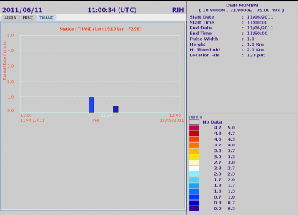

Slide 12
Vertical Integrated Liquid (VIL)
The aim of the Vertical Integrated Liquid (VIL) product is to give an instantaneous estimate of the liquid water content residing in a user-defined atmospheric layer in the atmosphere. For this reason, the VIL product will need volume scan reflectivity data. These reflectivity data are converted into liquid water content data using following relationship:
Z = C * MD
whereZ – reflectivity factor [mm6/m3], M (g/m3) – Liquid water content and C and D are constants. The values of C and D depend on type hydrometeors. The following table gives possible values for C and D

Slide 13
C-value | D value | Type of hydrometeors | Reference
24000 | 1.82 | Rain | Douglas, 1964
0.048 | 2.0 | Clouds | Atlas, 1954
3800 | 1.46 | Precipitationparticles in cumulus congestusclouds | Brown and Braham, 1963
For each vertical column the liquid water content is integrated within the user defined boundaries of the atmospheric layer to VIL value in g/m2
it is converted in equivalent column height considering water density as one). This product is an excellent tool to indicate the rainfall potential, probability of hail, severe weather etc.

Slide 14
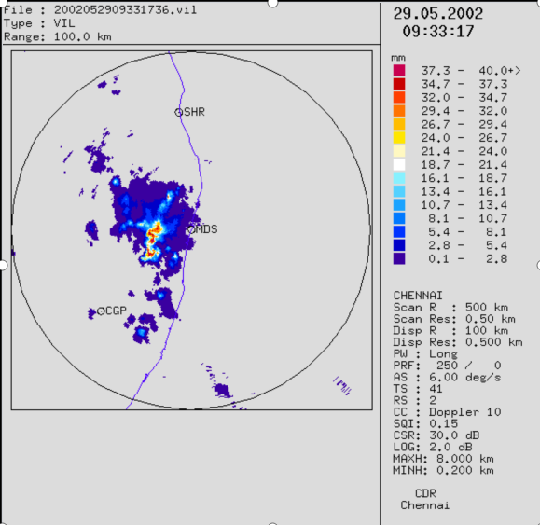

Slide 15
Hail Warning (HHW)
Algorithm for hail detection uses only reflectivity values (thresholds) above freezing level. Two thresholds, one for probable hail and other for very probable are defined by the operator. The algorithm searches the volume data containing reflectivity values for the bins that matches the thresholds layer by layer.
A pixel in the product image is set to probable hail or very probable hail if any of the bins above this pixel has a reflectivity value that is higher than or equal to the hail thresholds and is also above the freezing level. The areas of probable and very probable are marked in different colours.

Slide 16
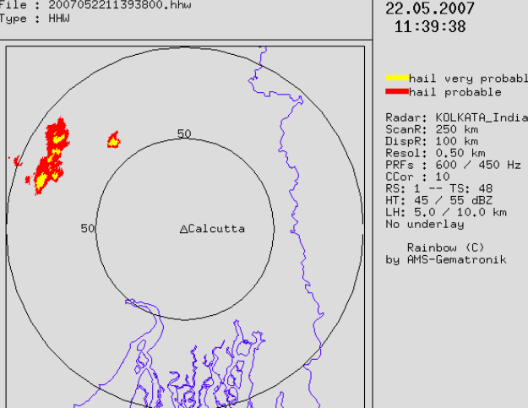

Slide 17
WARNING (WRN)
The warning product is a second level product. This means that the warning product depends on other products (also called first level products) and not on raw data.
During normal operation Genesis builds first level products from raw data sets coming directly from the radar or from archived data. Every time a product is generated Genesis checks whether the warning condition is active and whether all base products that are needed to create the warning product are available.
It is also checked that all these products have the same time stamp. Every time the time stamp changes, the warning product restarts and discards the files collected so far.

Slide 18
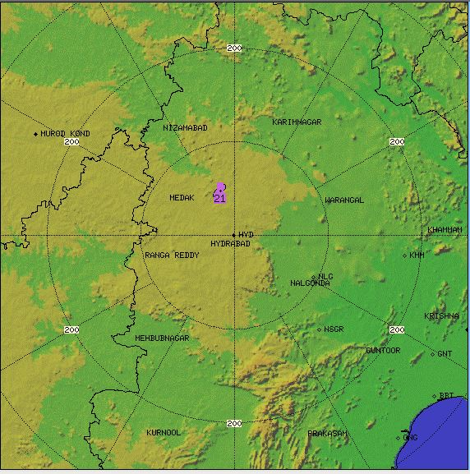

Slide 19
Storm Tracking (TRK)
The tracking product is a second level product. It takes other products as input and looks for cells that match the conditions defined in the warning product definition. Some characteristic values are calculated for every cell and saved in a display list. So far this is very similar to the warning product. The tracking algorithm takes subsequent display lists as input and tries to couple the cells in these lists.
This is an iterative process, i.e. if there are uncoupled cells after the first run then the algorithm starts again with less restrictive conditions until all acceptable couplings have been found. The last step is a forecast about the future movement of the cells in the latest scan. Cells are assumed to move on with unchanged speed and direction. Speed and direction are either calculated from the subsequent positions of coupled cells or, if there is no coupling, from the overall movement of all cells. A tracking product can depend on more than one base product.

Slide 20
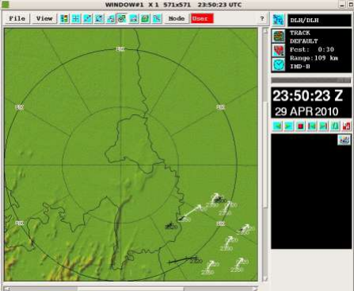

Slide 21
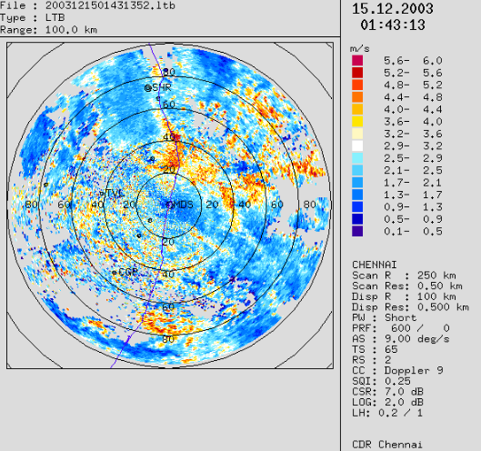
Layer Turbulence (LTB)
Layer Turbulence is Max display of spectral width values. It takes volume data set. The algorithm finds maximum value of spectral width in each vertical column and display in top projection. It is just like a PPI type of display.

Slide 22
Radial Shear (RDS)
The Radial Shear product profiles the derivative of radial wind velocity in radial direction, at each measurement bin, on a single elevation polar plane.
The product is generated for a user specified single elevation. For volume-scan data files, the scan elevation nearest to the user specified elevation is selected.
If the input is above half beam width of the lowest scan elevation or is below half beam width of the lowest scan elevation the shear product is not generated.

Slide 23
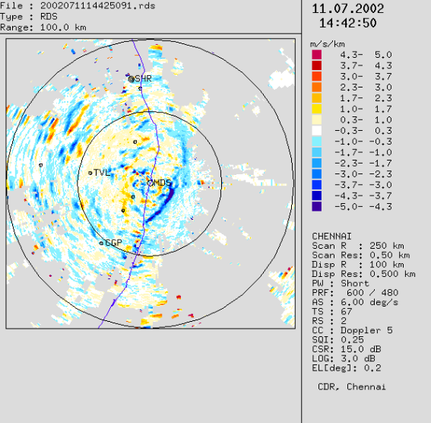

Slide 24
Thanks

